Slide 1
Electronics of Radio
Notes on David Rutledge’s book
John Manferdelli
johnmanferdelli@hotmail.com

Slide 2
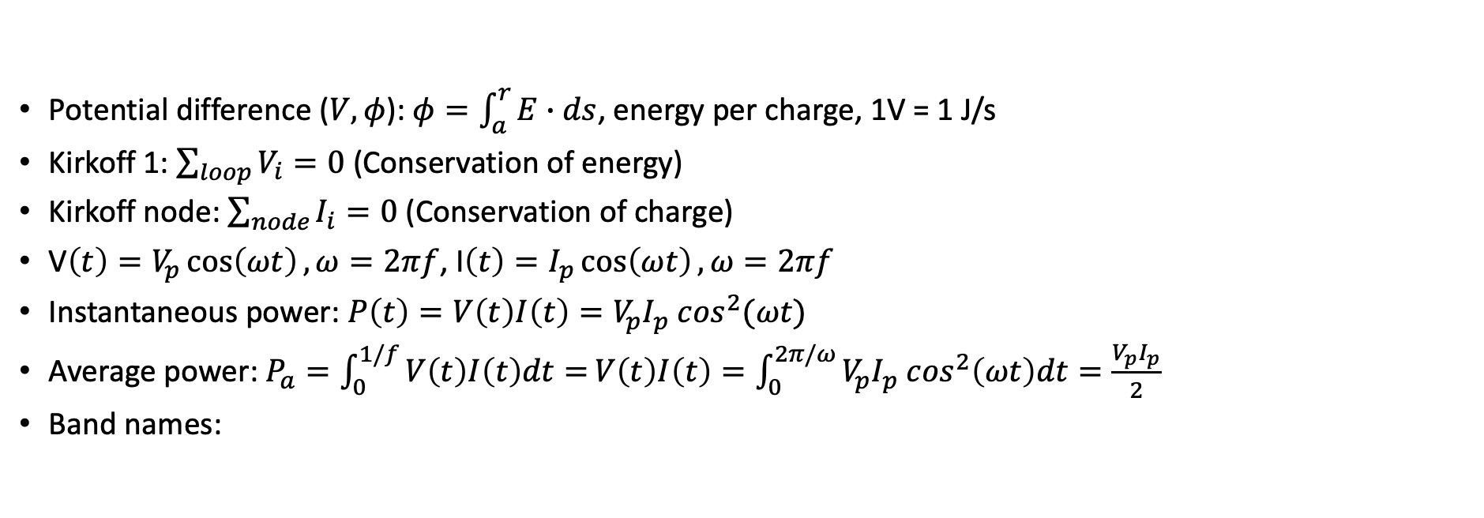
Basic concepts
Potential difference ($V, φ$): $φ=\int_{a}^{r}{E∙ds}$, energy per charge, 1V = 1 J/s
Kirkoff 1: $\sum_{loop}{V_{i}=0}$ (Conservation of energy)
Kirkoff node: $\sum_{node}{I_{i}=0}$ (Conservation of charge)
V$\left(t\right)=V_{p}\cos\left(ωt\right), ω=2πf$, I$\left(t\right)=I_{p}\cos\left(ωt\right), ω=2πf$
Instantaneous power: $P\left(t\right)=V\left(t\right)I\left(t\right)=V_{p}I_{p} \cos^{2}(ωt)$
Average power: $P_{a}=\int_{0}^{1/f}{V\left(t\right)I\left(t\right)dt=}V\left(t\right)I\left(t\right)=\int_{0}^{2π/ω}{V_{p}I_{p} \cos^{2}\left(ωt\right)dt}=\frac{V_{p}I_{p}}{2}$
Band names:
Name | Frequency
VLF | 3-30kHz
LW | 20-300kHz
MW | 300kHz-3MHz
HF | 3MHz-30MHz
VHF | 30-300MHz
Name | Frequency
UHF | 300MHz-1GHz
uW | 1-30GHz
milliW | 30-300GHz
submilliF | >300GHz

Slide 3

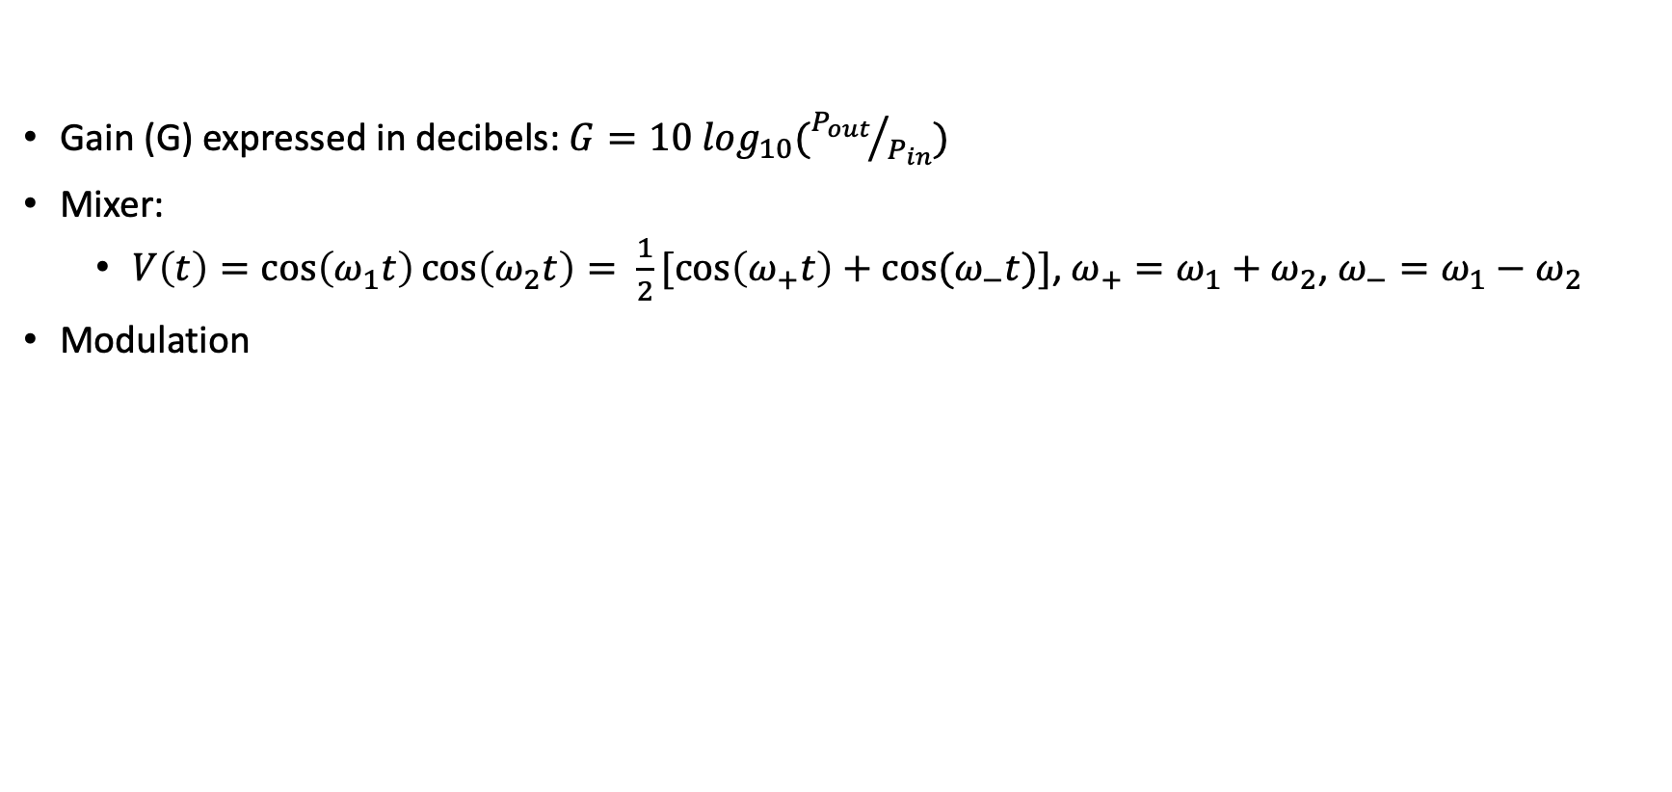
Signals
Gain (G) expressed in decibels: $G=10 \log_{10}({P_{out}}/{P_{in}})$
Mixer:
$V\left(t\right)=\cos\left(ω_{1}t\right)\cos\left(ω_{2}t\right)= \frac{1}{2}[\cos\left(ω_{+}t\right)+cos⁡(ω_{−}t)]$, $ω_{+}=ω_{1}+ω_{2}$, $ω_{−}=ω_{1}−ω_{2}$
Modulation
Name | Equation
AM | $$V\left(t\right)=a\left(t\right)cos⁡(ω_{c}t)$$
FM | $$V\left(t\right)=V_{c}cos⁡({(ω}_{c}+a\left(t\right))t)$$
FSK | $V\left(t\right)=V_{c}cos⁡(ω_{1}t)$, if 1 $V\left(t\right)=V_{c}cos⁡(ω_{0}t)$, if 0
PSK | $V\left(t\right)={+V}_{p}cos⁡(ωt)$, if 1 $V\left(t\right)=−V_{p}cos⁡(ωt)$, if 0

Slide 4



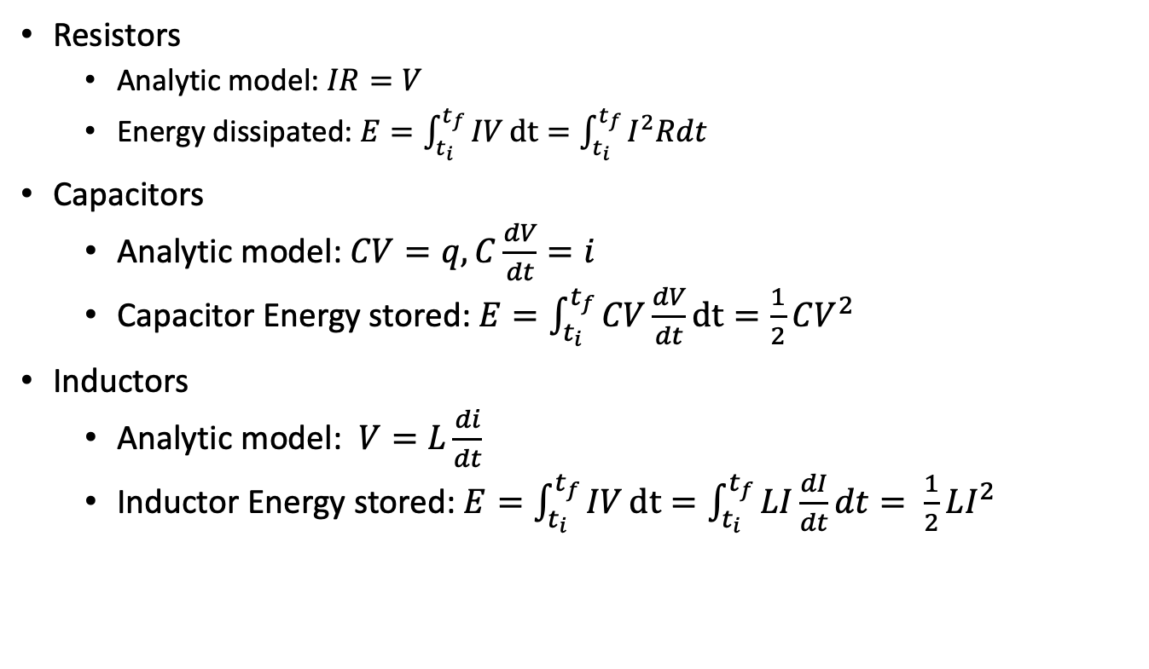
Resistors, capacitors, inductors
Resistors
Analytic model: $IR=V$
Energy dissipated: $E=\int_{t_{i}}^{t_{f}}{IV}dt=\int_{t_{i}}^{t_{f}}{I^{2}Rdt}$
Capacitors
Analytic model: $CV=q, C\frac{dV}{dt}=i$
Capacitor Energy stored: $E=\int_{t_{i}}^{t_{f}}{CV\frac{dV}{dt}}dt=\frac{1}{2}CV^{2}$
Inductors
Analytic model: $V=L\frac{di}{dt}$
Inductor Energy stored: $E=\int_{t_{i}}^{t_{f}}{IV}dt=\int_{t_{i}}^{t_{f}}{LI\frac{dI}{dt}dt= \frac{1}{2}LI^{2}}$
R
Credit: Make Electronics

Slide 5

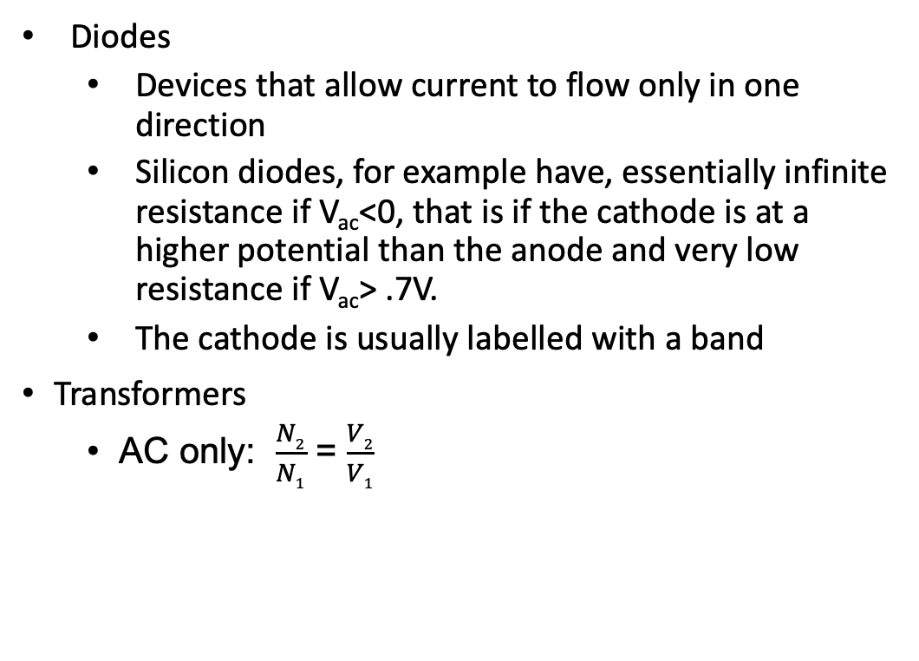
Diodes, transformers
Diodes
Devices that allow current to flow only in one direction
Silicon diodes, for example have, essentially infinite resistance if V_{ac}<0, that is if the cathode is at a higher potential than the anode and very low resistance if V_{ac}> .7V.
The cathode is usually labelled with a band
Transformers
AC only: $\frac{N2}{N1}$ = $\frac{V2}{V1}$
Credit: Make Electronics

Slide 6
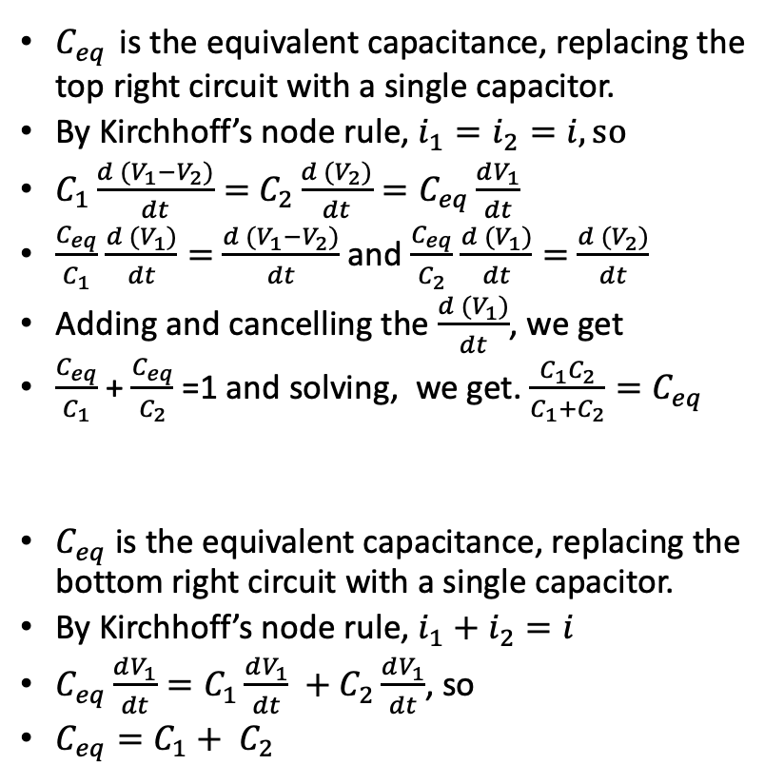
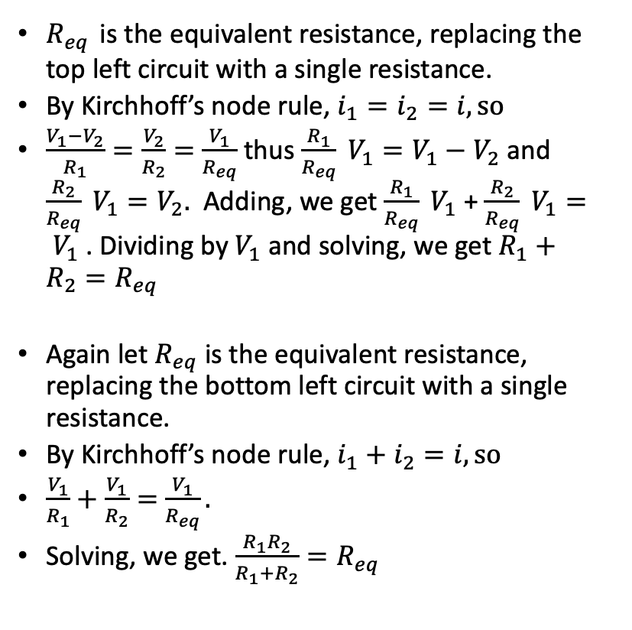
Simple circuit analysis with Kirchhoff
$R_{eq}$ is the equivalent resistance, replacing the top left circuit with a single resistance.
By Kirchhoff’s node rule, $i_{1}=i_{2}=i, so$
$\frac{V_{1}−V_{2}}{R_{1}}=\frac{V_{2}}{R_{2}}=$ $\frac{V_{1}}{R_{eq}}$ thus $\frac{R_{1}}{R_{eq}} V_{1}=V_{1}−V_{2}$ and $\frac{R_{2}}{R_{eq}} V_{1}=V_{2}.$ Adding, we get $\frac{R_{1}}{R_{eq}} V_{1}$ + $\frac{R_{2}}{R_{eq}} V_{1}= V_{1}$ . Dividing by $V_{1}$ and solving, we get $R_{1}+R_{2}=R_{eq}$
Again let $R_{eq}$ is the equivalent resistance, replacing the bottom left circuit with a single resistance.
By Kirchhoff’s node rule, $i_{1}+i_{2}=i, so$
$\frac{V_{1}}{R_{1}}+\frac{V_{1}}{R_{2}}=$ $\frac{V_{1}}{R_{eq}}.$
Solving, we get. $\frac{R_{1}R_{2}}{R_{1}+R_{2}}=R_{eq}$
$C_{eq}$ is the equivalent capacitance, replacing the top right circuit with a single capacitor.
By Kirchhoff’s node rule, $i_{1}=i_{2}=i, so$
$C_{1}\frac{d (V_{1}−V_{2})}{dt}=$ $C_{2}\frac{d (V_{2})}{dt}=C_{eq}\frac{dV_{1}}{dt}$
$\frac{C_{eq}}{C_{1}}$ $\frac{d (V_{1})}{dt}=$ $\frac{d (V_{1}−V_{2})}{dt}$ and $\frac{C_{eq}}{C_{2}}$ $\frac{d (V_{1})}{dt}=$ $\frac{d (V_{2})}{dt}$
Adding and cancelling the $\frac{d (V_{1})}{dt}$, we get
$\frac{C_{eq}}{C_{1}}$ + $\frac{C_{eq}}{C_{2}}$ =1 and solving, we get. $\frac{C_{1}C_{2}}{C_{1}+C_{2}}=C_{eq}$
$C_{eq}$ is the equivalent capacitance, replacing the bottom right circuit with a single capacitor.
By Kirchhoff’s node rule, $i_{1}+i_{2}=i$
$C_{eq}\frac{dV_{1}}{dt}=C_{1}\frac{dV_{1}}{dt} +C_{2}\frac{dV_{1}}{dt}$, so
$C_{eq}=C_{1}+ C_{2}$
V₁
V₁
R₁
i₁
i
C₁
i₁
V₂
i
R₂
i₂
V₂
C₂
i₂
V=0
V=0
V₁
i
R₁
i₁
V₁
R₂
i₂
i
C₁
i₁
C₂
i₂
V=0
V=0

Slide 7
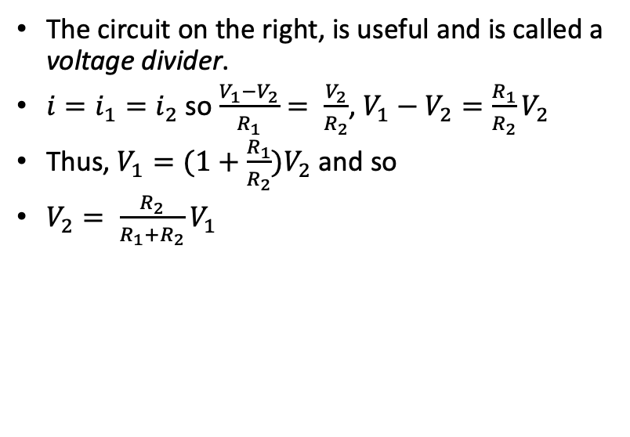
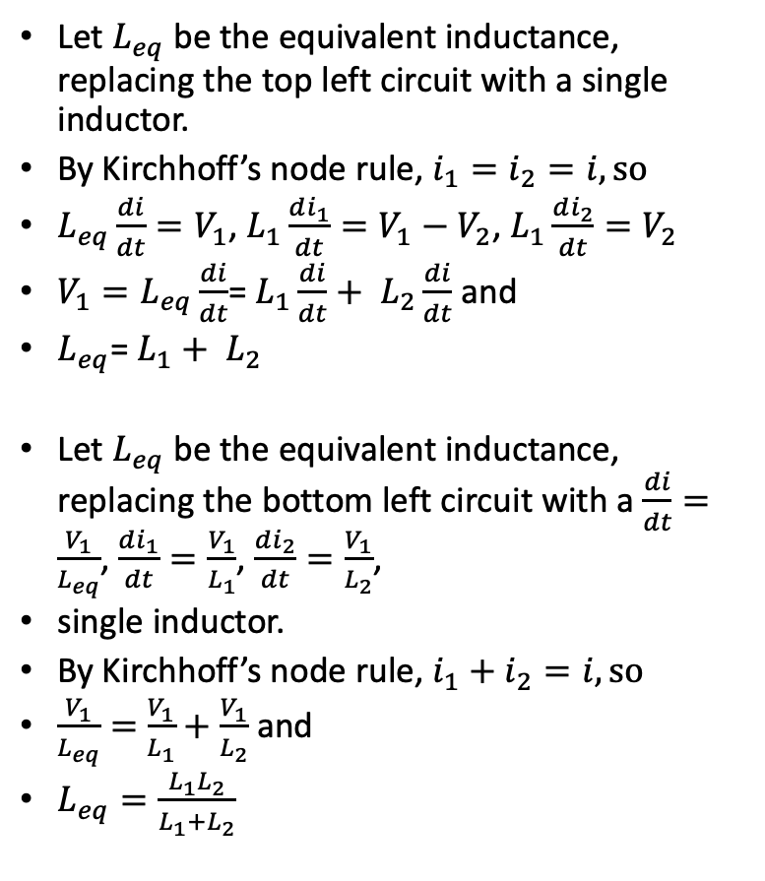
Simple circuit analysis with Kirchhoff
V₁
Let $L_{eq}$ be the equivalent inductance, replacing the top left circuit with a single inductor.
By Kirchhoff’s node rule, $i_{1}=i_{2}=i, so$
$L_{eq}\frac{di}{dt}=V_{1}$, $L_{1}\frac{di_{1}}{dt}=V_{1}−V_{2}$, $L_{1}\frac{di_{2}}{dt}=V_{2}$
${V_{1}=L}_{eq}\frac{di}{dt}$= $L_{1}\frac{di}{dt}+ L_{2}\frac{di}{dt}$ and
$L_{eq}$= $L_{1}+ L_{2}$
Let $L_{eq}$ be the equivalent inductance, replacing the bottom left circuit with a $\frac{di}{dt}=\frac{V_{1}}{L_{eq}}$, $\frac{di_{1}}{dt}=\frac{V_{1}}{L_{1}}$, $\frac{di_{2}}{dt}=\frac{V_{1}}{L_{2}}$,
single inductor.
By Kirchhoff’s node rule, $i_{1}+i_{2}=i, so$
$\frac{V_{1}}{L_{eq}}=$ $\frac{V_{1}}{L_{1}}+\frac{V_{1}}{L_{2}}$ and
$L_{eq}=\frac{L_{1}L_{2}}{L_{1}+L_{2}}$
L₁
i₁
i
V₂
L₂
i₂
The circuit on the right, is useful and is called a voltage divider.
$i=i_{1}=i_{2}$ so $\frac{V_{1}−V_{2}}{R_{1}}= \frac{V_{2}}{R_{2}}$, $V_{1}−V_{2}=\frac{R_{1}}{R_{2}}V_{2}$
Thus, $V_{1}=(1+\frac{R_{1}}{R_{2}})V_{2}$ and so
$V_{2}= \frac{R_{2}}{R_{1}+R_{2}}V_{1}$
V=0
V₁
R₁
i₁
i
V₁
V₂
R₂
i₂
i
L₁
L₂
V=0
i₁
i₂
V=0

Slide 8


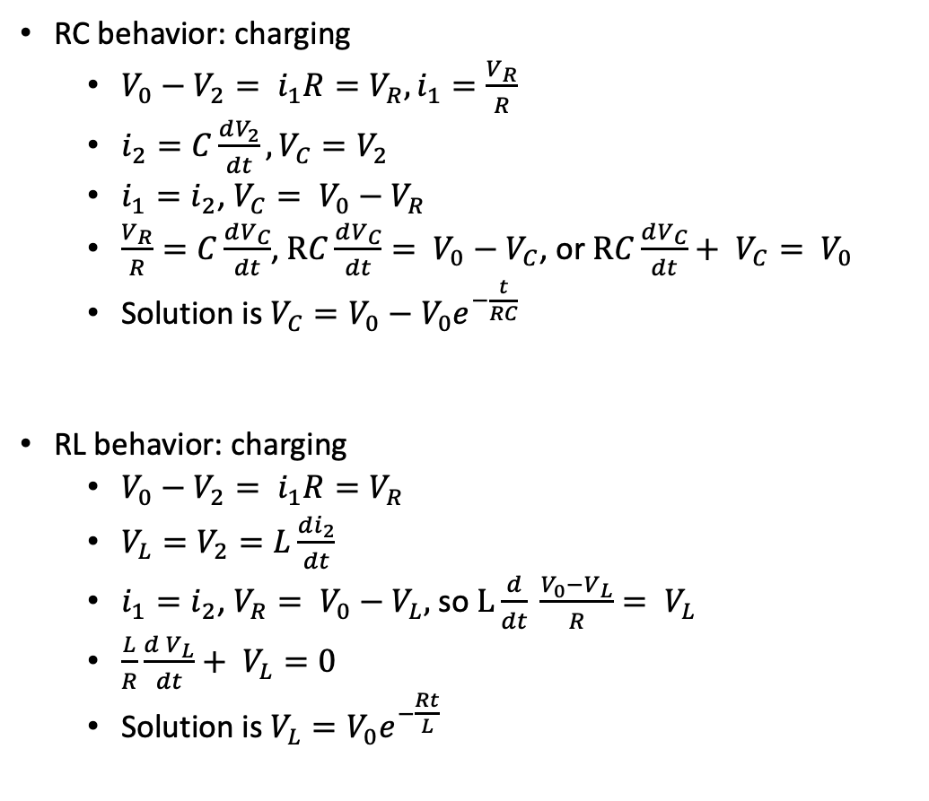
Simple circuit analysis with Kirchhoff
RC behavior: charging
$V_{0}−V_{2}= i_{1}R=V_{R}, i_{1}=\frac{V_{R}}{R}$
$i_{2}=C\frac{dV_{2}}{dt},V_{C}=V_{2}$
$i_{1}=i_{2}$, $V_{C}= V_{0}−V_{R}$
$\frac{V_{R}}{R}=C\frac{dV_{C}}{dt}$,$RC\frac{dV_{C}}{dt}= V_{0}−V_{C}$, or $RC\frac{dV_{C}}{dt}+ V_{C}= V_{0}$
Solution is $V_{C}=V_{0}−V_{0}e^{−\frac{t}{RC}}$
RL behavior: charging
$V_{0}−V_{2}= i_{1}R=V_{R}$
$V_{L}=V_{2}=L\frac{di_{2}}{dt}$
$i_{1}=i_{2}$, $V_{R}= V_{0}−V_{L},$ so $L\frac{d}{dt} \frac{V_{0}−V_{L}}{R}= V_{L}$
$\frac{L}{R}\frac{d V_{L}}{dt}+ V_{L}=0$
Solution is $V_{L}=V_{0}e^{−\frac{Rt}{L}}$
V₀
R
i₁
+
V₂
-
C
i₂
V₀
R
i₁
+
V₂
-
L
i₂
C₂

Slide 9
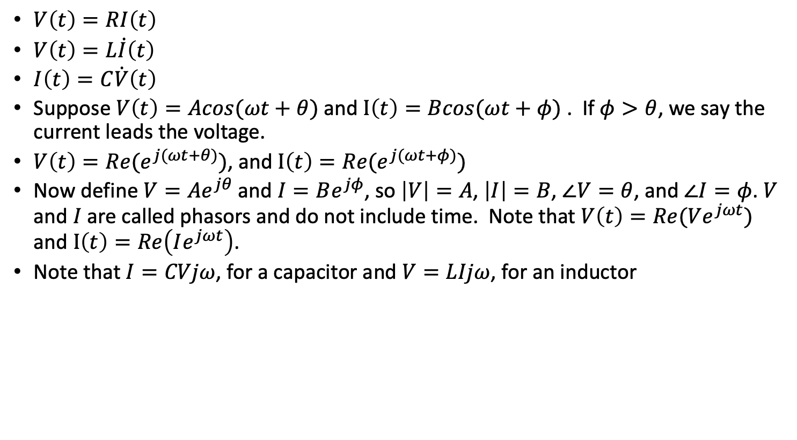
Phasors
$V\left(t\right)=RI\left(t\right)$
$V\left(t\right)=L\dot{I}\left(t\right)$
$I\left(t\right)=C\dot{V}\left(t\right)$
Suppose $V\left(t\right)=Acos(ωt+θ)$ and $I\left(t\right)=Bcos(ωt+φ)$ . If $φ>θ$, we say the current leads the voltage.
$V\left(t\right)=Re(e^{j(ωt+θ)})$, and $I\left(t\right)=Re(e^{j(ωt+φ)})$
Now define $V=Ae^{jθ}$ and $I=Be^{jφ}$, so $\left|V\right|=A$, $\left|I\right|=B$, $∠V=θ$, and $∠I=φ$. $V$ and $I$ are called phasors and do not include time. Note that $V\left(t\right)=Re(Ve^{jωt})$ and $I\left(t\right)=Re\left(Ie^{jωt}\right)$.
Note that $I=CVjω$, for a capacitor and $V=LIjω$, for an inductor

Slide 10
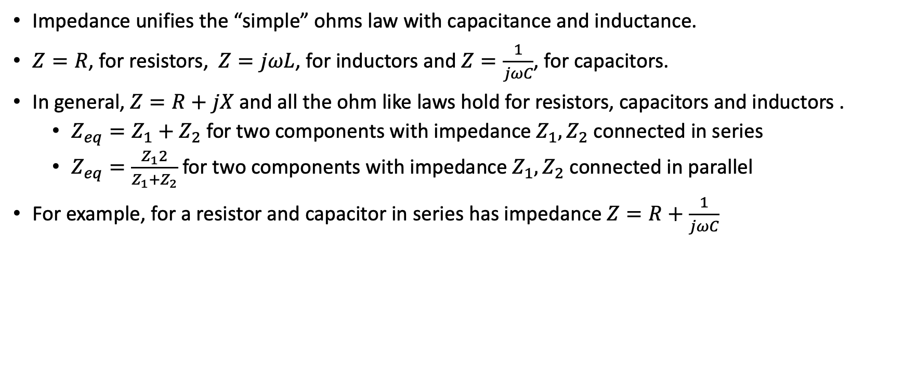
Circuit analysis with Kirchhoff and impedance
Impedance unifies the “simple” ohms law with capacitance and inductance.
$Z=R$, for resistors, $Z=jωL$, for inductors and $Z=\frac{1}{jωC}$, for capacitors.
In general, $Z=R+jX$ and all the ohm like laws hold for resistors, capacitors and inductors .
$Z_{eq}=Z_{1}+Z_{2}$ for two components with impedance $Z_{1}, Z_{2}$ connected in series
$Z_{eq}=\frac{Z_{1}2}{Z_{1}+Z_{2}}$ for two components with impedance $Z_{1}, Z_{2}$ connected in parallel
For example, for a resistor and capacitor in series has impedance $Z=R+\frac{1}{jωC}$

Slide 11
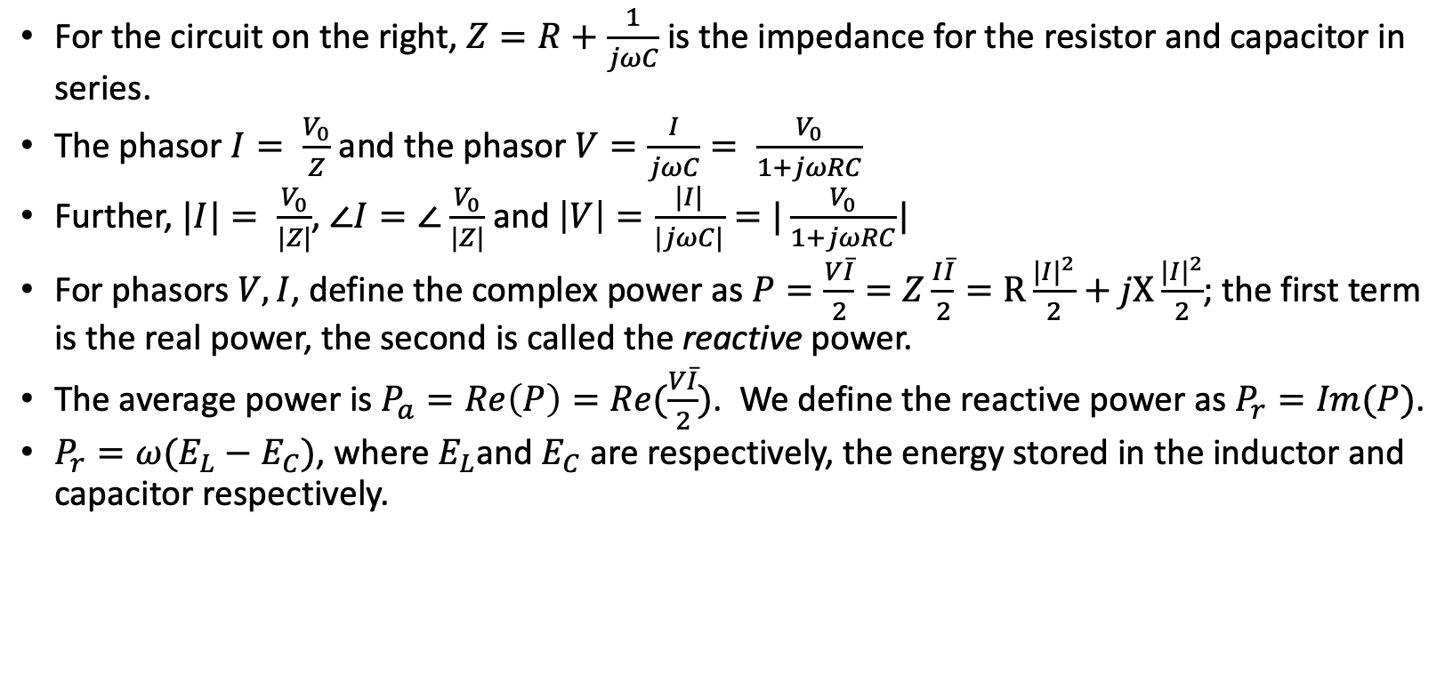
Phasors, impedance and power
For the circuit on the right, $Z=R+\frac{1}{jωC}$ is the impedance for the resistor and capacitor in series.
The phasor $I= \frac{V_{0}}{Z}$ and the phasor $V=\frac{I}{jωC}= \frac{V_{0}}{1+jωRC}$
Further, $|I|= \frac{V_{0}}{|Z|}$, $∠I=∠$ $\frac{V_{0}}{|Z|}$ and $\left|V\right|=\frac{|I|}{|jωC|}=|\frac{V_{0}}{1+jωRC}$|
For phasors $V,I$, define the complex power as $P=\frac{V\overline{I}}{2}=Z\frac{I\overline{I}}{2}=R\frac{{|I|}^{2}}{2}+jX\frac{{|I|}^{2}}{2}$; the first term is the real power, the second is called the reactive power.
The average power is $P_{a}=Re\left(P\right)=Re(\frac{V\overline{I}}{2})$. We define the reactive power as $P_{r}=Im(P)$.
$P_{r}=ω(E_{L}−E_{C})$, where $E_{L}$and $E_{C}$ are respectively, the energy stored in the inductor and capacitor respectively.
R
V₀
C
I
V

Slide 12
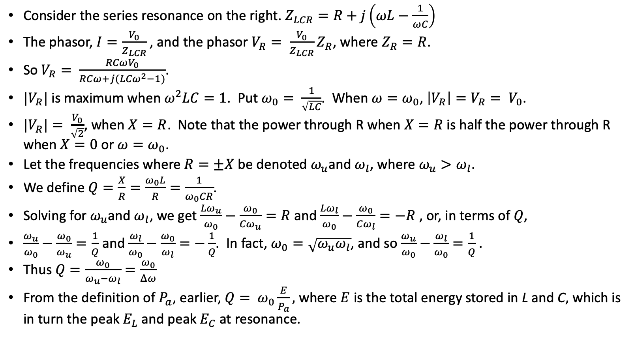
Q and phasors
Consider the series resonance on the right. $Z_{LCR}=R+j\left(ωL−\frac{1}{ωC}\right)$
The phasor, $I=\frac{V_{0}}{Z_{LCR}}$, and the phasor $V_{R}= \frac{V_{0}}{Z_{LCR}}Z_{R}$, where $Z_{R}=R$.
So $V_{R}= \frac{RCωV_{0}}{RCω+j({LCω}^{2}−1)}$.
$|V_{R}|$ is maximum when$ω^{2}LC=1$. Put $ω_{0}= \frac{1}{\sqrt{LC}}$. When $ω=ω_{0}$, $\left|V_{R}\right|=V_{R}= V_{0}$.
${|V}_{R}|= \frac{V_{0}}{\sqrt{2}}$, when $X=R$. Note that the power through R when $X=R$ is half the power through R when $X=0$ or $ω=ω_{0}$.
Let the frequencies where $R=±X$ be denoted $ω_{u}$and $ω_{l}$, where $ω_{u}>ω_{l}$.
We define $Q=\frac{X}{R}=\frac{ω_{0}L}{R}=\frac{1}{ω_{0}CR}$.
Solving for $ω_{u}$and $ω_{l}$, we get $\frac{{Lω}_{u}}{ω_{0}}−\frac{ω_{0}}{{Cω}_{u}}=R$ and $\frac{{Lω}_{l}}{ω_{0}}−\frac{ω_{0}}{{Cω}_{l}}=−R$ , or, in terms of $Q$,
$\frac{ω_{u}}{ω_{0}}−\frac{ω_{0}}{ω_{u}}=\frac{1}{Q}$ and $\frac{ω_{l}}{ω_{0}}−\frac{ω_{0}}{ω_{l}}=−\frac{1}{Q}$. In fact, $ω_{0}=\sqrt{ω_{u}ω_{l}}$, and so $\frac{ω_{u}}{ω_{0}}−\frac{ω_{l}}{ω_{0}}=\frac{1}{Q}$ .
Thus $Q=\frac{ω_{0}}{ω_{u}−ω_{l}}=\frac{ω_{0}}{Δω}$
From the definition of $P_{a}$, earlier, $Q= ω_{0}\frac{E}{P_{a}},$ where $E$ is the total energy stored in L and C, which is in turn the peak $E_{L}$ and peak $E_{C}$ at resonance.
L
C
V₀
R
V_{R}

Slide 13
Phasors, impedance and power
For the circuit on the right, $Z=R+\frac{1}{jωC}$ is the impedance for the resistor and capacitor in series.
The phasor $I= \frac{V_{0}}{Z}$ and the phasor $V=\frac{I}{jωC}= \frac{V_{0}}{1+jωRC}$
Further, $|I|= \frac{V_{0}}{|Z|}$, $∠I=∠$ $\frac{V_{0}}{|Z|}$ and $\left|V\right|=\frac{|I|}{|jωC|}=|\frac{V_{0}}{1+jωRC}$|
For phasors $V,I$, define the complex power as $P=\frac{V\overline{I}}{2}=Z\frac{I\overline{I}}{2}=R\frac{{|I|}^{2}}{2}+jX\frac{{|I|}^{2}}{2}$; the first term is the real power, the second is called the reactive power.
The average power is $P_{a}=Re\left(P\right)=Re(\frac{V\overline{I}}{2})$. We define the reactive power as $P_{r}=Im(P)$.
$P_{r}=ω(E_{L}−E_{C})$, where $E_{L}$and $E_{C}$ are respectively, the energy stored in the inductor and capacitor respectively.
R
V₀
C
I
V

Slide 14
Thevenin and Norton
Thevenin: Any combination of linear sources and passive elements terminating in two terminals is equivalent to a pure voltage source in series with an impedance
Norton: Any combination of linear sources and passive elements terminating in two terminals is equivalent to a pure current source in parallel with an conductance
Similar theorems for two terminal input and output devices (with transfer function)
Z_{Th}
V_{Th}
I_{N}
G_{Th}

Slide 15
Thevenin and Norton
Lookback
R₁
R₃
V₀
R₂

Slide 16
Exercise 1: Resistors
R_{s}
R_{l}
+
V₀
-
x
R₁
R₂
+
R₃
V₀
-
R₂
+
R₁
R₃
V₀
-

Slide 17
Exercise 2: Sources
x

Slide 18
Exercise 3: Capacitors
x
R_{s}
R
C
V₀

Slide 19
Exercise 4: Diode detectors
x

Slide 20
Exercise 5: Inductors
x

Slide 21
Exercise 6: Diodes and snubbers
x

Slide 22

Exercise 7: Parallel to Series conversion
$Use 50Ω$ scope probe

Slide 23
Exercise 8: Series resonance
C₁
L₁
15uH
$Use 50Ω$ scope probe

Slide 24
Exercise 9: Parallel resonance
C₃₇
5pF
$Use 50Ω$ scope probe
C₃₈
100pF
L₆

Slide 25

Direct conversion and superhet receivers
Image frequencies
Superheterodyne designs
RF
Filter
$$⊗$$
RF Mixer
LO
Audio
Amp
Direct conversion

Slide 26
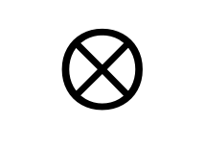


Norcal 40A
7 MHz
2W
<10 MHz
Harmonic
Filter
RF
Filter
Power
Amp
$$⊗$$
RF Mixer
20 mW
4.9 MHz
9.1 MHz
Driver
IF Filter
300 uW
VFO
2.1 MHz
Product
Detector
Buffer
$$⊗$$
BFO
4.9 MHz
10 uW
9.8 MHz
Audio
Transmit
Filter
AGC
7 MHz
2.8 MHz
Transmit
Mixer
$$⊗$$
AGC
Detector
Audio
Amp
Key
Transmit oscillator
4.9 MHz

Slide 27
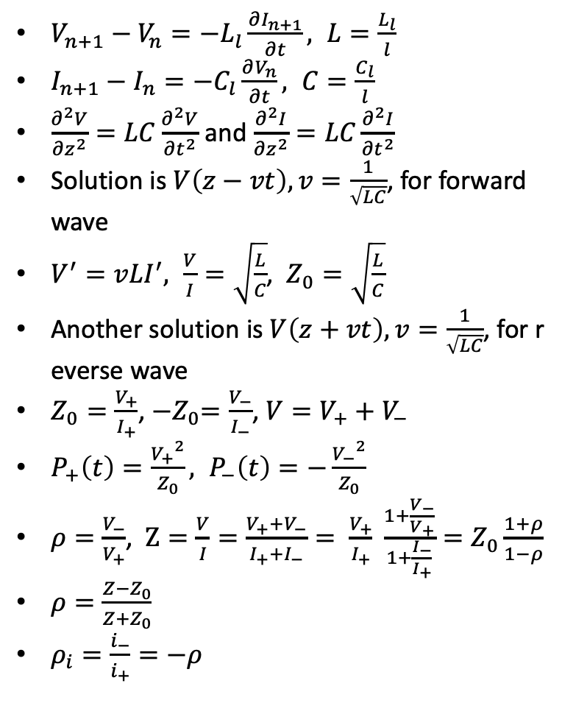
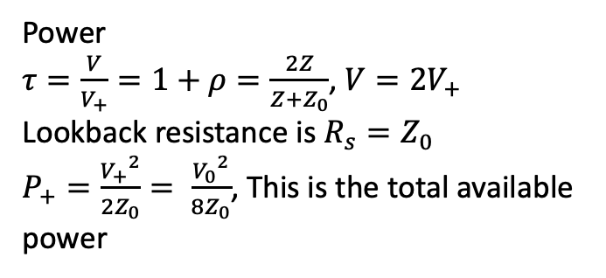
Transmission Lines
$V_{n+1}−V_{n}=−L_{l}\frac{∂I_{n+1}}{∂t}, L=\frac{L_{l}}{l}$
$I_{n+1}−I_{n}=−C_{l}\frac{∂V_{n}}{∂t}, C=\frac{C_{l}}{l}$
$\frac{∂^{2}V}{{∂z}^{2}}=LC\frac{∂^{2}V}{{∂t}^{2}}$ and $\frac{∂^{2}I}{{∂z}^{2}}=LC\frac{∂^{2}I}{{∂t}^{2}}$
Solution is $V\left(z−vt\right), v=\frac{1}{\sqrt{LC}}$, for forward wave
$V^{′}=vLI^{′}, \frac{V}{I}=\sqrt{\frac{L}{C}}$, $Z_{0}=\sqrt{\frac{L}{C}}$
Another solution is $V\left(z+vt\right), v=\frac{1}{\sqrt{LC}}$, for reverse wave
$Z_{0}=\frac{V_{+}}{I_{+}}$, ${−Z}_{0}=\frac{V_{−}}{I_{−}}$, $V=V_{+}+V_{−}$
$P_{+}\left(t\right)=\frac{{V_{+}}^{2}}{Z_{0}}, P_{−}\left(t\right)=−\frac{{V_{−}}^{2}}{Z_{0}}$
$ρ=\frac{V_{−}}{V_{+}}$, $Z=\frac{V}{I}=\frac{V_{+}+V_{−}}{I_{+}+I_{−}}= \frac{V_{+}}{I_{+}} \frac{1+\frac{V_{−}}{V_{+}}}{1+\frac{I_{−}}{I_{+}}}=Z_{0}\frac{1+ρ}{1−ρ}$
$ρ=\frac{Z−Z_{0}}{Z+Z_{0}}$
$ρ_{i}=\frac{i_{−}}{i_{+}}=−ρ$
I_{n}
V_{n}
L_{l}
…
C_{l}
Power
$τ=\frac{V}{V_{+}}=1+ρ=\frac{2Z}{Z+Z_{0}}$, $V=2V_{+}$
Lookback resistance is $R_{s}=Z_{0}$
$P_{+}=\frac{{V_{+}}^{2}}{2Z_{0}}= \frac{{V_{0}}^{2}}{8Z_{0}}$, This is the total available power

Slide 28
Transmission Lines - continued
x

Slide 29
Exercise 10: Coax
10m
$Use 50Ω$ scope probe

Slide 30
Exercise 10: Waves
$Use 50Ω$ scope probe

Slide 31
Exercise 12: Resonance
10m
$Use 50Ω$ scope probe

Slide 32


Filters
Low pass
L₂
L₄
C₁
C₂
C₃
High pass
C₁
C₂
C₃
Bandpass - WIkipedia
L₂
L₄
7 MHz bandpass
C₁ (34.5 pF)
L₂ (15 uH)
C₂ (6nF)
L₄ (8nH)
Bandpass - WIkipedia

Slide 33
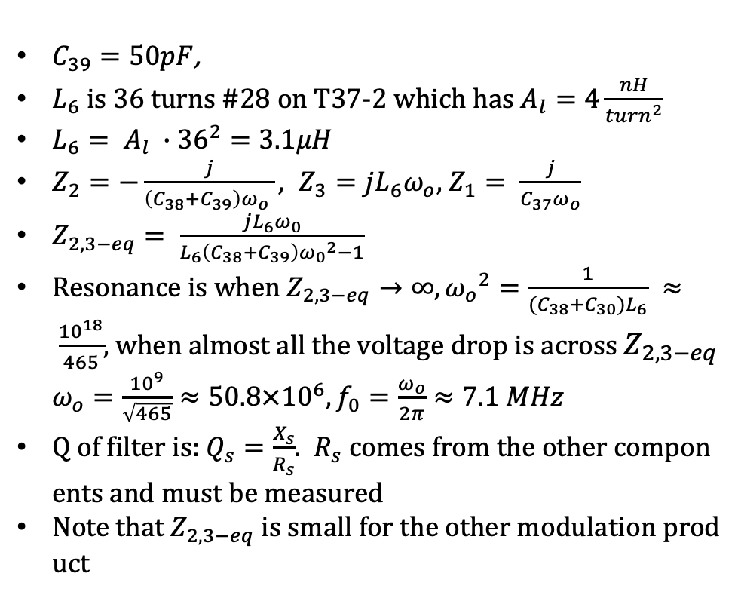
Norcal transmit bandpass filter
$C_{39}=50pF$,
$L_{6}$ is 36 turns #28 on T37-2 which has $A_{l}=4\frac{nH}{{turn}^{2}}$
$L_{6}= A_{l} ∙{36}^{2}=3.1μH$
$Z_{2}=−\frac{j}{\left(C_{38}+C_{39}\right)ω_{o} }, Z_{3}=jL_{6}ω_{o}$, $Z_{1}= \frac{j}{C_{37}ω_{o}}$
$Z_{2,3−eq}= \frac{jL_{6}ω_{0}}{L_{6}\left(C_{38}+C_{39}\right){ω_{0}}^{2}−1}$
Resonance is when $Z_{2,3−eq}→∞, {ω_{o}}^{2}=\frac{1}{(C_{38}+C_{30})L_{6}} ≈ \frac{{10}^{18}}{465}$, when almost all the voltage drop is across $Z_{2,3−eq}$ $ω_{o}=\frac{{10}^{9}}{\sqrt{465}}≈50.8×{10}^{6}, f_{0}=\frac{ω_{o}}{2π}≈7.1 MHz$
Q of filter is: $Q_{s}=\frac{X_{s}}{R_{s}}$. $R_{s}$ comes from the other components and must be measured
Note that $Z_{2,3−eq}$ is small for the other modulation product
C37 (5pF)
C₃₉
C₃₈ (100pF)
L₆

Slide 34
Norcal RF Filter
C₁
50 pF
L₁
15uH
RX Ant
8V TX
2N4124
To RF
Mixer
R₁
1.8K
R₂
1K
C₃
47nF
To receiver
switch

Slide 35
Exercise 13: Norcal Harmonic Filter
L₇
L₈
Power amp, or,
function generator
Antenna
Jack out
C₄₅
330pF
C₄₆
820pF
C₄₇
330pF
L₇, L₈ use T37-2 core, 18 turns, 1.3uH
Compare loss at 7MHz and 14MHz

Slide 36
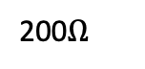
Exercise 14: Norcal IF Cohn Filter
X₁ through X₄ are 4.91 MHz
C₁₀, C₁₁, C₁₂ are 270 pF
Set function generator to 50mV_{pp} from function generator
Calculate R and X for filter
C₉
X₁
X₂
X₃
X₄
C₁₃
C₁₀
C₁₁
C₁₂
L₉ (18 uH)
200$Ω$
C₁₄
47pF
To SA602 wants 1.5K
Matching network
Equivalent circuit for
crystal and generator

Slide 37
Transformers
$x$

Slide 38
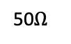
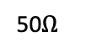
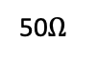
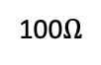
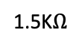
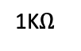
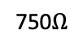
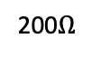
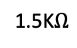
Norcal matching transformers
T₁ is driver matcher uses FT 37-43
Measurement circuit below
T₁, 14:4
50$Ω$
200$Ω$
100$Ω$
50$Ω$
1K$Ω$
T₂ is RF matcher uses FT 37-61
Measurement circuit below
C₄
5pF
T₂, 1:20
50$Ω$
C₂
50pF
1.5K$Ω$
T₃, 23:6
T₃ is IF matcher uses FT 37-61
Measurement circuit below
L₄, 18uH
750$Ω$
C₁₄
47pF
C₆
47pF
1.5K$Ω$

Slide 39
Exercise 15: Norcal Driver Transformers
$x$
T₁ is driver matcher uses FT 37-43
Measurement circuit below
T₁, 14:4
50$Ω$
200$Ω$
100$Ω$
50$Ω$
1K$Ω$

Slide 40
Exercise 16: Norcal Tuned Transformers
T₂ is RF matcher uses FT 37-61
Measurement circuit below
C₄
5pF
$x$
T₂, 1:20
50$Ω$
C₂
50pF
1.5K$Ω$
T₃, 23:6
T₃ is IF matcher uses FT 37-61
Measurement circuit below
L₄, 18uH
750$Ω$
C₁₄
47pF
C₆
47pF
1.5K$Ω$

Slide 41
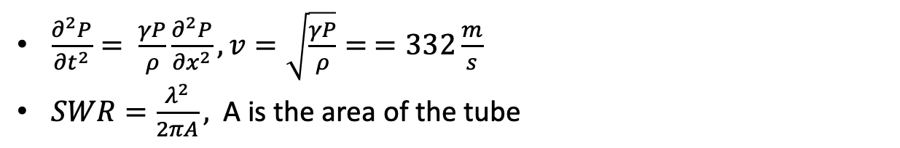
Acoustics
$\frac{∂^{2}P}{{∂t}^{2}}= \frac{γP}{ρ}\frac{∂^{2}P}{{∂x}^{2}}, v=\sqrt{\frac{γP}{ρ}}= =332\frac{m}{s}$
$SWR=\frac{λ^{2}}{2πA},$ A is the area of the tube

Slide 42
Exercise 17: Tuned Speaker
$x$

Slide 43
Exercise 18: Acoustic Standing Wave
$x$

Slide 44

Bipolar Transistors
NPN, PNP
Model
i_{C} = 𝛼i_{E}
i_{C}= 𝛽i_{B}
𝛽 = 𝛼/(1- 𝛼)
𝛽 ∼ 100
v_{s}
R_{S}
Bipolar source model
b
c
r_{p}
bi_{b}
e
Bipolar equivalent circuit

Slide 45
Bipolar Switches
NPN, PNP
Model
i_{C} = 𝛼i_{E}
i_{C}= 𝛽i_{B}
𝛽 = 𝛼/(1- 𝛼)
𝛽 ∼ 100

Slide 46
BJT common emitter amplifier
Here’s how to design a common emitter amplifier. We use a 2n3904 transistor with 𝛽=150. This circuit will work! Build it.
Pick the supply voltage V_{cc}=12V.
Choose a gain (amplification factor), A = 5.
Choose the “Q point” of the conducting transistor (4mA).
V_{cc} = (i_{c}∙R_{C}) + V_{ce} + i_{e} R_{E} ∼ i_{e}∙ (R_{C}+R_{E}) +V_{ce} with i_{c}=4mA. We get (R_{C}+R_{E}) = (V_{cc} - V_{ce})/(4mA) =1.75 k𝝮.
Since A = 5 and A=R_{C}/R_{E}, R_{C}= 5 R_{E} so R_{E} ∼ 270 𝝮 (this is a standard resistor value) and R_{C}= 1.5k𝝮.
V_{CC}
R_{C}
R₁
C_{o}
C_{i}
v_{s}
R₂
v_{s}
R_{E}
Common emitter amp
Credit: Ward, Hands on Radio.

Slide 47
BJT common emitter amplifier continued
i_{b} = 4mA/𝛽 = 27 𝝁A.
Since V_{be} must be greater than .7V throughout the input signal range, we want the voltage across R₂ to satisfy V_{be} + i_{c}R_{E} = 1.8V.
We insert a voltage divider consisting of R₁ and R_{2,} so that R₁= (12-1.8)/270 𝝁A ∼ 39 k𝝮.
C_{o} and C_{i} are picked to offer small resistance to the frequency range we’re interested in and C_{o} = C_{i} = 5 𝝁F.
I haven’t explained why we want R_{E} but it provides thermal stability for the transistor over the range we care about. The fact that A=R_{C}/R_{E} can be calculated using Kirchhoff’s laws.
V_{CC}
R_{C}
R₁
C_{o}
C_{i}
v_{s}
R₂
v_{s}
R_{E}
Common emitter amp
Credit: Ward, Hands on Radio.

Slide 48
BJT common collector amplifier
V_{CC}
d
R₁
C_{i}
C_{o}
v_{s}
R₂
R_{E}
Common collector amp (Emitter Follower)
Common collector amp
Credit: Ward, Hands on Radio.

Slide 49
BJT common collector amplifier continued
x
V_{CC}
R₁
C_{i}
v_{s}
R₂
R_{E}
Common collector amp (Emitter Follower)
Credit: Ward, Hands on Radio.

Slide 50
BJT common base amplifier
x
V_{CC}
C_{i}
R_{C}
R_{E}
R₁
v_{s}
v_{i}
R₂
C_{B}
Common base amp

Slide 51
BJT common base amplifier continued
x
V_{CC}
C_{i}
R_{C}
R_{E}
R₁
v_{i}
R₂
C_{B}
Common base amp

Slide 52
JFETs

Slide 53
JFET Common Emitter Amplifier
x
R_{D}
C_{out}
C_{in}
G
out
D
in
R_{G}
S
R_{S}
v_{s}
v_{s}

Slide 54
JFET common emitter amplifier continued
x

Slide 55
JFET common source amplifier
d
R_{D}
C_{out}
C_{in}
G
out
D
in
R_{G}
S
R_{S}

Slide 56
JFET Common Source Amplifier continued
x
R_{D}
C_{out}
C_{in}
G
out
D
in
R_{G}
S
R_{S}

Slide 57
JFET common drain amplifier
x
C_{in}
G
D
in
C_{out}
S
R_{G}
out
R_{S}
R_{L}

Slide 58
JFET common drain amplifier continued
x
C_{in}
G
D
in
C_{out}
S
R_{G}
out
R_{S}
R_{L}

Slide 59
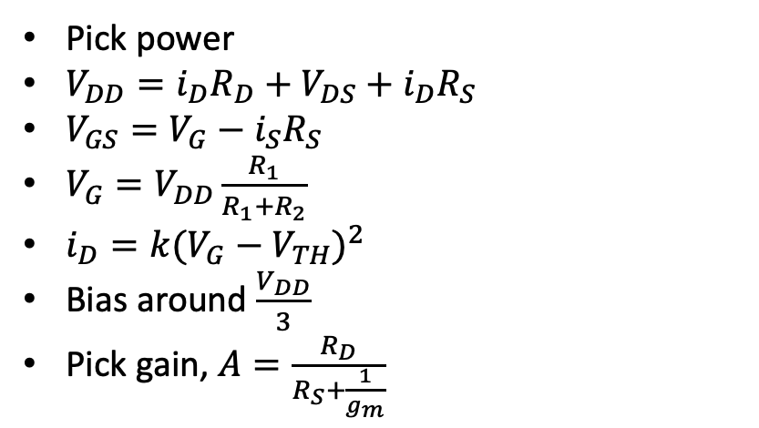
CMOS common emitter amplifier
V_{DD}
Pick power
$V_{DD}=i_{D}R_{D}+V_{DS}+i_{D}R_{S}$
$V_{GS}=V_{G}−i_{S}R_{S}$
$V_{G}=V_{DD}\frac{R_{1}}{R_{1}+R_{2}}$
$i_{D}=k{(V_{G}−V_{TH})}^{2}$
Bias around $\frac{V_{DD}}{3}$
Pick gain, $A=\frac{R_{D}}{R_{S}+\frac{1}{g_{m}}}$
R_{D}
D
C_{i}
R₁
C_{o}
S
R₂
R_{S}

Slide 60
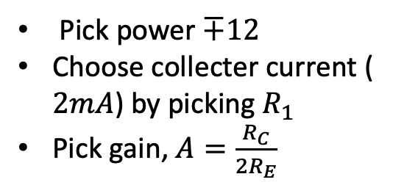
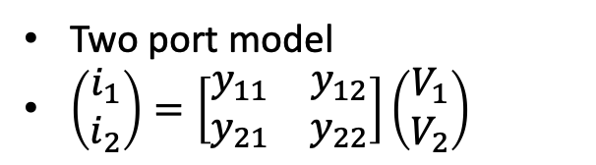
Differential Amplifier
Two port model
$\left(\begin{matrix}i_{1} \\ i_{2}\end{matrix}\right)=\left[\begin{matrix}y_{11} & y_{12} \\ y_{21} & y_{22}\end{matrix}\right]\left(\begin{matrix}V_{1} \\ V_{2}\end{matrix}\right)$
Pick power $∓12$
Choose collecter current ($2mA$) by picking $R_{1}$
Pick gain, $A=\frac{R_{C}}{2R_{E}}$
Differential amplifier
R_{C}
R_{C}
v_{in}
v_{O}
v_{in}
R_{E}
R_{E}
R₁

Slide 61
Exercise 19: Norcal receiver switch
C₁
50pF
Receiver mixer or an oscilloscope with 50$Ω$
L₁ (15uH)
8V TX
2N4124
R₁
1.8K
C₂
47nF
When transistor conducts the receiver filter shorts
Harmonic filter
If using function generator
use a 1.8K resistor

Slide 62
Exercise 20: NorCal transmitter switch
2N3906
When key is down, transistor conducts
8V
8V TX
R₂₄ (150K)
R₉ (47K)
Key jack
C₄₇ (47nF)
relay

Slide 63
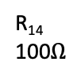
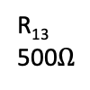
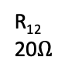
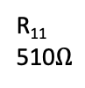
Exercise 21: Norcal Driver
8V
out
T₁
R₁₄
100$Ω$
2N2222A
$Use 50Ω$ scope probe
R₁₁
510$Ω$
R₁₂
20$Ω$
R₁₃
500$Ω$
+
Key jack
C₅₆
10uF
C₄₈
10nF

Slide 64
Exercise 22: Emitter degeneration
$Use 50Ω$ scope probe

Slide 65
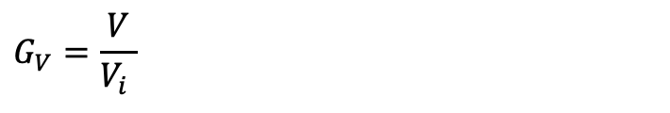
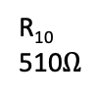
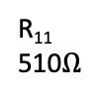
Exercise 23: Norcal Buffer amplifier
8V TX
C₃₆
47nF
Function
Generator
C₃₉
50pF
Pin 4 transmit
mixer
C₃₇
5pF
R₁₀
510$Ω$
1.5K
Driver
C₃₈
100pF
C₅₀
25pF
L₆
3.1uF
J309
R₁₁
510$Ω$
$$G_{V}=\frac{V}{V_{i} }$$

Slide 66
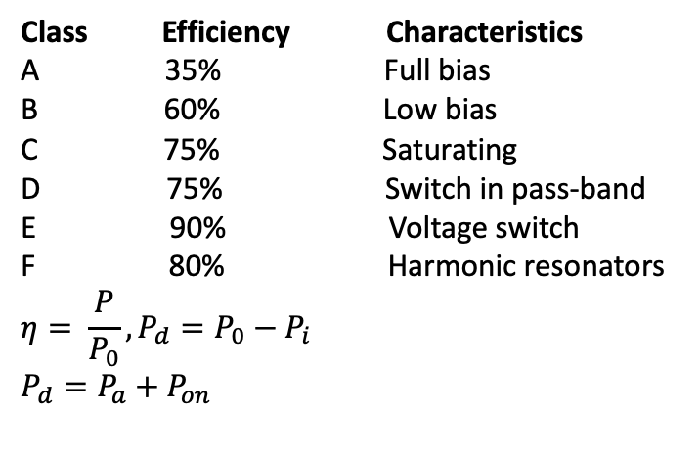
Amplifier classes
I
I
V
Class Efficiency Characteristics
A 35% Full bias
B 60% Low bias
C 75% Saturating
D 75% Switch in pass-band
E 90% Voltage switch
F 80% Harmonic resonators
$$η= \frac{P}{P_{0}}, P_{d}=P_{0}−P_{i}$$
$$P_{d}=P_{a}+P_{on}$$
t
t
t
Class A
Class B
Class C
V
V
V
t
t
t
Class D
Class E
Class F

Slide 67
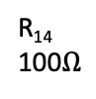
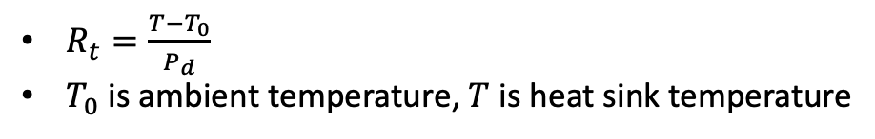
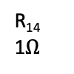
Exercise 24: Norcal Power Amp
Norcal-40 Power amp is class C
8V
R₁₄
1$Ω$
Supply power
3,200 mW
RFC
18uH
Active loss
P_{a}, 260 mW
2N3553
Harmonic
Filter
Power transistor
Driver
C₄₄
47nF
R₁₄
100$Ω$
IN4753A
Active loss
P_{on}, 430 mW
Antenna
2500 mW
$R_{t}=\frac{T−T_{0}}{P_{d}}$
$T_{0}$ is ambient temperature, $T$ is heat sink temperature

Slide 68
Exercise 25: Power modelling
$Use 50Ω$ scope probe

Slide 69
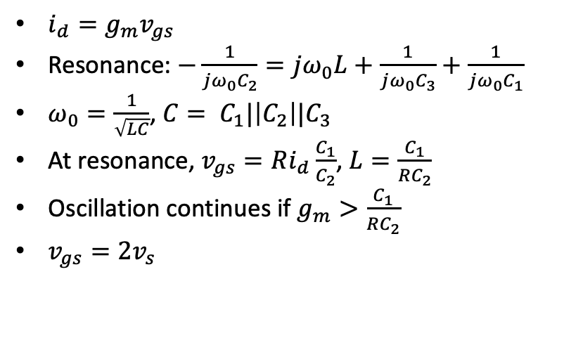
Clapp oscillator
9v
$i_{d}=g_{m}v_{gs}$
Resonance: $−\frac{1}{jω_{0}C_{2}}=jω_{0}L+\frac{1}{jω_{0}C_{3}}+\frac{1}{jω_{0}C_{1}}$
$ω_{0}=\frac{1}{\sqrt{LC}}$, $C= C_{1}|\left|C_{2}\right||C_{3}$
At resonance, $v_{gs}=Ri_{d}\frac{C_{1}}{C_{2}}$, $L=\frac{C_{1}}{RC_{2}}$
Oscillation continues if $g_{m}>\frac{C_{1}}{RC_{2}}$
$v_{gs}=2v_{s}$
C₃
C₁ (1200pF)
L (19uH)
C₂ (1200 pF)
out
R

Slide 70
Norcal Receiver Incremental Tuning (RIT)
RIT 1
R₁₆
1K
R₁₅
510
LM393
8
1
7
8V
2
3
C₄
5pF
6
4
5
on
1.4V
From VFO
off
8V TX
LM393 is a comparator
For function generator connect through 1.5K

Slide 71
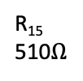
Exercise 26: Norcal VFO
RIT 1
R₁₇
10K
R₂₀
4.7K
8V
C₅₄
47nF
R₁₉
47K
C₄₉
47pF
C₅₁
390pF
J309
R₁₅
510$Ω$
LM393 pin 7
C₅₂
1200pF
R₂₃
1.8K
C₅₀
25pF
D₉
R₂₁
47K
D₈
MVAM108
L₉
TX VFO
C₇
10pnF
C₅₃
1200pF
RFC
1mH
RX VFO
C₃₂
150 pF
L9: T68-7 62 turns
Check MVAM108 capacitor when R₁₇ is high and low
Start resistor (R₂₁) pulls gat to ground at start
When gain limiting diode (D9) conducts, it pulls gate negative
Oscillator keeps growing as long as g_{m}>1/R

Slide 72
Exercise 27: Gain limiting
$x$

Slide 73
Mixers
$x$

Slide 74
Exercise 28: Norcal RF Mixer
8V
C₄
5pF
SA602
RF
Filter
8
C₂
50pF
1
T₂
C₁₈
47nF
7
2
C₅
10nF
6
RX VFO
3
50mVpp if
using function
generator
From VCO
4
5
C₆
47pF
T₃
IF Filter

Slide 75
Exercise 29: Norcal Product Detector
8V
1.4V
SA602
C₁₈
270 pF
8
1
IF in
7
2
C_{15. +}
2.2uF
C₁₇
50 pF
3
6
4
5
4.91 MHz
AF1
AF2
620 Hz output through AF1 and AF2

Slide 76
Exercise 30: Norcal transmit mixer and oscillator
8V
TX VFO
C₃₁
5 pF
SA602
C₃₆
270 pF
8
1
7
2
C₃₃
47nF
C₃₄
50 pF
L₅
18 uH
3
6
5
4
4.91 MHz
Buffer
Amp

Slide 77
Exercise 31: Norcal Audio Amp
8V
C₂₃
2.2uF
+
C₅₅ (10 nF)
1
2
8
R₂₂
1.8K
+
Audio in
5
3
386
4
-
6
+
+
C₂₇ (100 uF)
AGC pt
C₃₀ (2.2 uF)
Speaker
R₆
500
+
C₂₆ (10 uF)

Slide 78
Exercise 32: Norcal AGC
Connect to
function generator
through 300K, here
8V TX
8V
R₂₀
4.7K
R₃
150K
C₄₁
100uF
C₅₅
100nF
AF2
J309
R_{5c}
2.2M
C₅₅
10nF
R_{5a}
2.2M
C₂₇
100uF
R₇
47K
To audio
in
D₁
D₂
From product
detector
C₂₈
100nF
Key tune
D₄
D₆
R₆
10K
Threshold
R_{5b}
2.2M
R_{5d}
2.2M
D₅
AGC pt at
audio amp
AF1
C₂₁
100nF

Slide 79
Exercise 33: Alignment
$x$

Slide 80
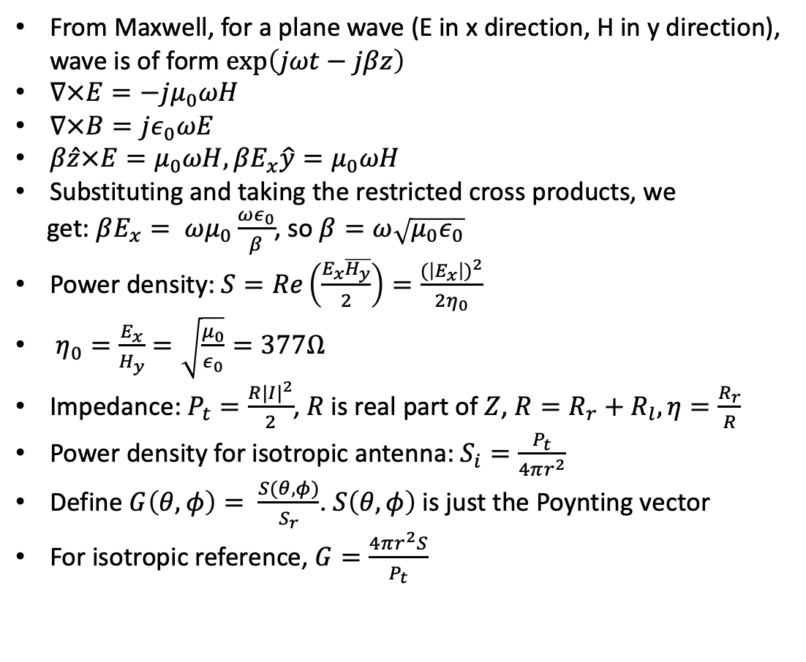
Antennas and propagation
From Maxwell, for a plane wave (E in x direction, H in y direction), wave is of form $\exp\left(jωt−jβz\right)$
$∇×E=−jμ_{0}ωH$
$∇×B=jε_{0}ωE$
$β\hat{z}×E=μ_{0}ωH, βE_{x}\hat{y}=μ_{0}ωH$
Substituting and taking the restricted cross products, we
get: $βE_{x}= ωμ_{0}\frac{ωε_{0}}{β}$, so $β=ω\sqrt{μ_{0}ε_{0}}$
Power density: $S=Re\left(\frac{E_{x}\overline{H_{y}}}{2}\right)=\frac{{(\left|E_{x}\right|)}^{2}}{2η_{0}}$
$η_{0}=\frac{E_{x}}{H_{y}}=\sqrt{\frac{μ_{0}}{ε_{0}}}=377Ω$
Impedance: $P_{t}=\frac{R{|I|}^{2}}{2}$, $R$ is real part of $Z$, $R=R_{r}+R_{l}, η=\frac{R_{r}}{R}$
Power density for isotropic antenna: $S_{i}=\frac{P_{t}}{4πr^{2}}$
Define $G\left(θ,φ\right)= \frac{S(θ,φ)}{S_{r}}$. $S\left(θ,φ\right)$ is just the Poynting vector
For isotropic reference, $G=\frac{4πr^{2}S}{P_{t}}$
Receiving antenna Thevenin
C
R

Slide 81
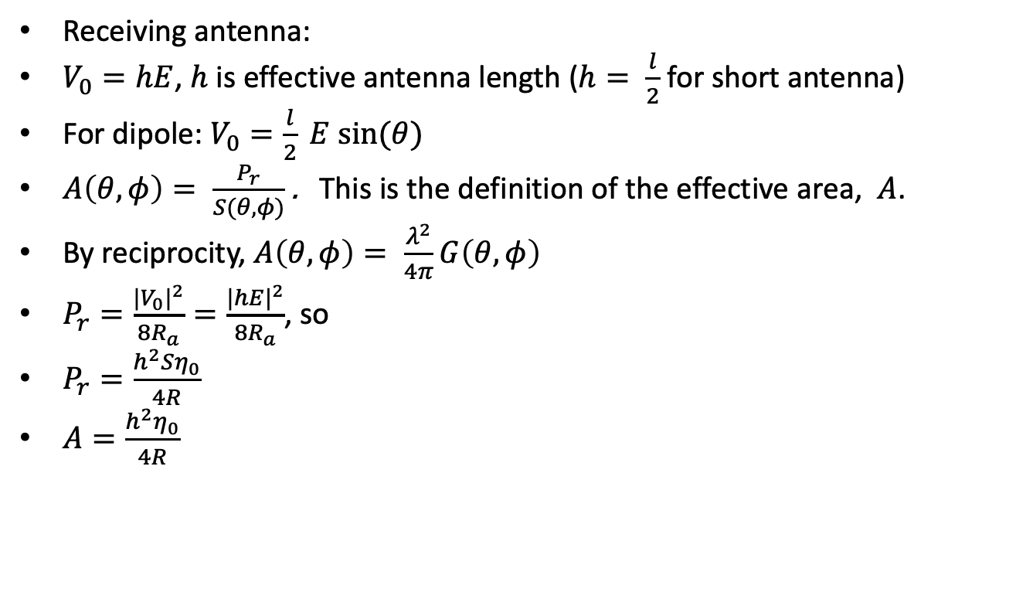
Antennas and propagation
Receiving antenna:
$V_{0}=hE$, $h$ is effective antenna length ($h= \frac{l}{2}$ for short antenna)
For dipole: $V_{0}=\frac{l}{2} E sin⁡(θ)$
$A\left(θ, φ\right)= \frac{P_{r}}{S(θ,φ)}$ . This is the definition of the effective area, $A$.
By reciprocity, $A\left(θ, φ\right)= \frac{λ^{2}}{4π}G\left(θ, φ\right)$
$P_{r}=\frac{{{|V}_{0}|}^{2}}{8R_{a}}=\frac{{|hE|}^{2}}{8R_{a}}$, so
$P_{r}=\frac{h^{2}Sη_{0}}{4R}$
$A=\frac{h^{2}η_{0}}{4R}$

Slide 82
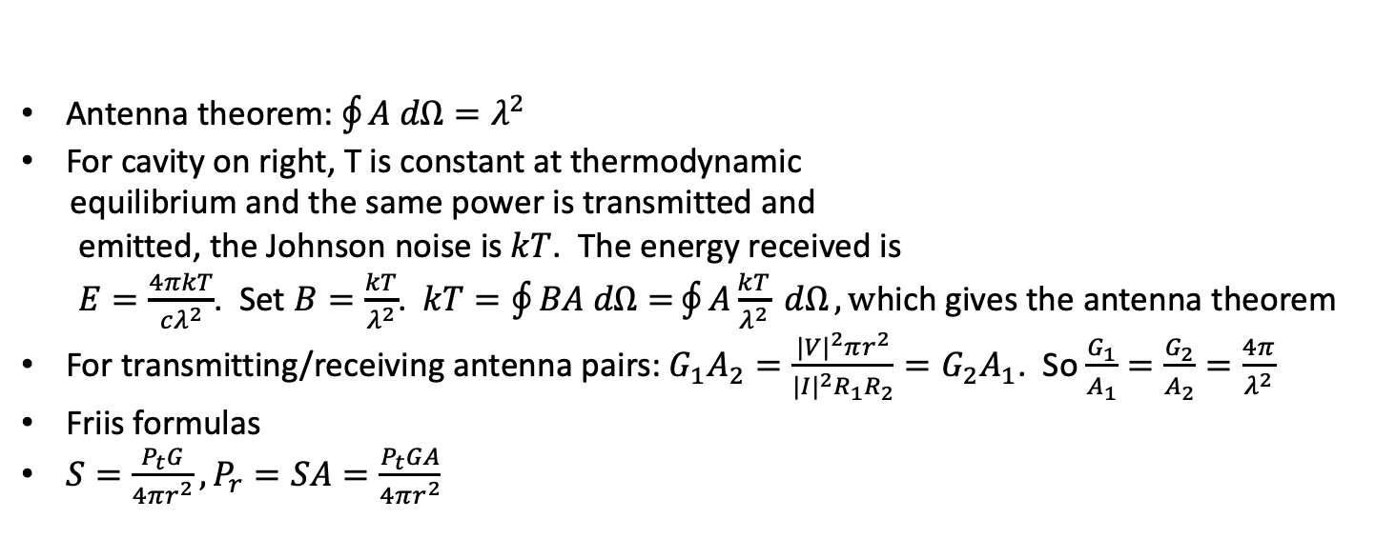
Antennas and propagation
Insulated cavity
T
A
Antenna theorem: $\oint{A dΩ=λ^{2}}$
For cavity on right, T is constant at thermodynamic
equilibrium and the same power is transmitted and
emitted, the Johnson noise is $kT$. The energy received is
$E=\frac{4πkT}{cλ^{2}}$. Set $B=\frac{kT}{λ^{2}}$. $kT=\oint{BA dΩ=}\oint{A\frac{kT}{λ^{2}} dΩ}, w$hich gives the antenna theorem
For transmitting/receiving antenna pairs: $G_{1}A_{2}=\frac{{|V|}^{2}πr^{2}}{{|I|}^{2}R_{1}R_{2}}=G_{2}A_{1}$. So $\frac{G_{1}}{A_{1}}=\frac{G_{2}}{A_{2}}=\frac{4π}{λ^{2}}$
Friis formulas
${S=\frac{P_{t}G}{4πr^{2}}, P}_{r}=SA=\frac{P_{t}GA}{4πr^{2}}$

Slide 83
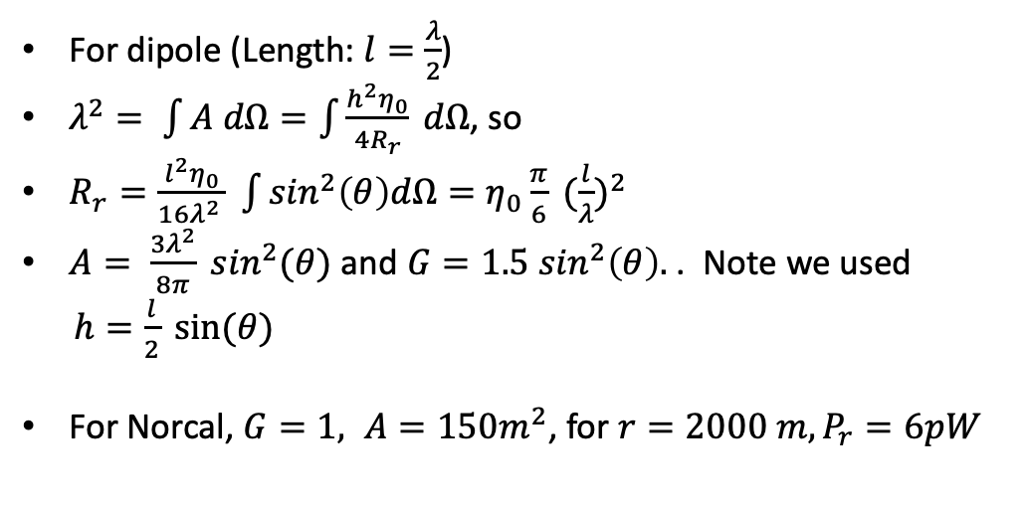
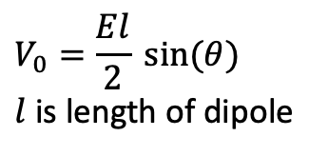
Reciprocity and dipole
Dipole Thevenin equivalent circuit
For dipole (Length: $l=\frac{λ}{2}$)
$λ^{2}= \int{A dΩ=\int{\frac{h^{2}η_{0}}{4R_{r}} dΩ}}$, so
$R_{r}=\frac{l^{2}η_{0}}{16λ^{2} } \int{\sin^{2}\left(θ\right)dΩ=η_{0}\frac{π}{6}} {(\frac{l}{λ})}^{2}$
$A= \frac{3λ^{2}}{8π} \sin^{2}(θ)$ and $G=1.5\sin^{2}\left(θ\right).$ . Note we used
$h=\frac{l}{2} sin⁡(θ)$
For Norcal, $G=1, A=150m^{2}$, for $r=2000 m, P_{r}=6pW$
C
R
$$V_{0}=\frac{El}{2} sin⁡(θ)$$
$l$ is length of dipole

Slide 84
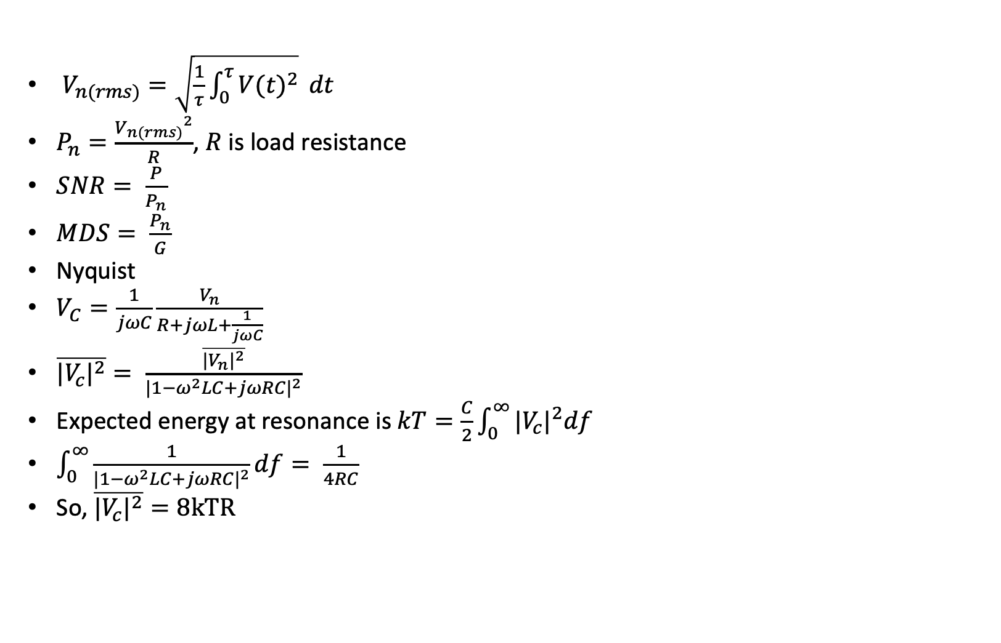
Noise
$V_{n(rms)}=\sqrt{\frac{1}{τ}\int_{0}^{τ}{{V(t)}^{2}}} dt$
$P_{n}=\frac{{V_{n(rms)}}^{2}}{R}$, $R$ is load resistance
$SNR= \frac{P}{P_{n}}$
$MDS= \frac{P_{n}}{G}$
Nyquist
$V_{C}=\frac{1}{jωC}\frac{V_{n}}{R+jωL+\frac{1}{jωC}}$
$\overline{{|V_{c}|}^{2}}= \frac{\overline{{|V_{n}|}^{2}}}{{|1−ω^{2}LC+jωRC|}^{2}}$
Expected energy at resonance is $kT=\frac{C}{2}\int_{0}^{∞}{{|V_{c}|}^{2}df}$
$\int_{0}^{∞}{\frac{1}{{|1−ω^{2}LC+jωRC|}^{2}}df}= \frac{1}{4RC}$
So, $\overline{{|V_{c}|}^{2}}=8kTR$

Slide 85
Exercise 35: Intermodulation
$x$

Slide 86
Exercise 37: Antennas
$x$

Slide 87
Exercise 38: Propagation
$x$

Slide 88
Norcal circuit diagram, 1

Slide 89
Norcal circuit diagram, 2

Slide 90
Norcal circuit diagram, 3

Slide 91
Norcal circuit diagram, 4

Slide 92
Norcal circuit diagram, 5

Slide 93
Morse
Symbol | Code | Symbol | Code | Symbol | Code
a | ._ | m | __ | y | _.__
b | _... | n | _. | z | __..
c | _._. | o | ___ | 0 | _____
d | _.. | p | .__. | 1 | .____
e | . | q | __._ | 2 | ..___
f | .._. | r | -_. | 3 | …__
g | __. | s | … | 4 | …._
h | …. | t | _ | 5 | …..
i | .. | u | .._ | 6 | _....
j | .___ | v | …_ | 7 | __...
k | _._ | w | .__ | 8 | ___..
l | ._.. | x | _.._ | 9 | ____.

Slide 94

Color codes
Resistors: ohms
Capacitors: picoFards
Inductors: milliHenries

Slide 95
Exercises
Voltage dividers
RC and RL circuit analysis
Resonance
Resistors and Thevenin
Sources
Capacitors
Inductors
Diodes and snubbers

Slide 96
Exercises
Parallel to series impedance conversion
Series resonance
Parallel resonance
Coaxial cables
Waves
Resonance and transmission lines
Harmonic Filter
IF filter

Slide 97
Exercises
Driver transformer
IF transformer
Coaxial cables
Tuned speaker
Acoustic standing wave
Transmitter switch
Driver amplifier

Slide 98
Exercises
Emitter degeneration
Buffer amplifier
Power amplifier
Thermal modelling
VFO
Gain limiting
RF mixer

Slide 99
Exercises
Product detector
Transmit mixer
Audio amplifier
AGC
Alignment
Receiver response
Intermodulation
Antennas
Propagation

Slide 100
Kirchhoff
There are two Kirkoff’s laws, one describes voltages the other describes currents.
i₁
i₄
V₁
V₂
V₃
V₄
i₂
i₅
i₃
i₆
V₅
V₆
i₁ + i₂ + i₃ + i₄ + i₅ + i₆ = 0
(V₂ - V₁) + (V₃ – V₂) + (V₄ - V₃) + (V₅ – V₄) + (V₆ - V₁) + (V₁ – V₆ )= 0

